Slide 1
Visual Aid

Slide 2
Table of Contents
A-Scan Mode …………………………………Page 3
B-Scan Mode …………………………………Page 15
UBM ………………………………..……………Page 23
Pachymeter.……………………..……………Page 31

Slide 3
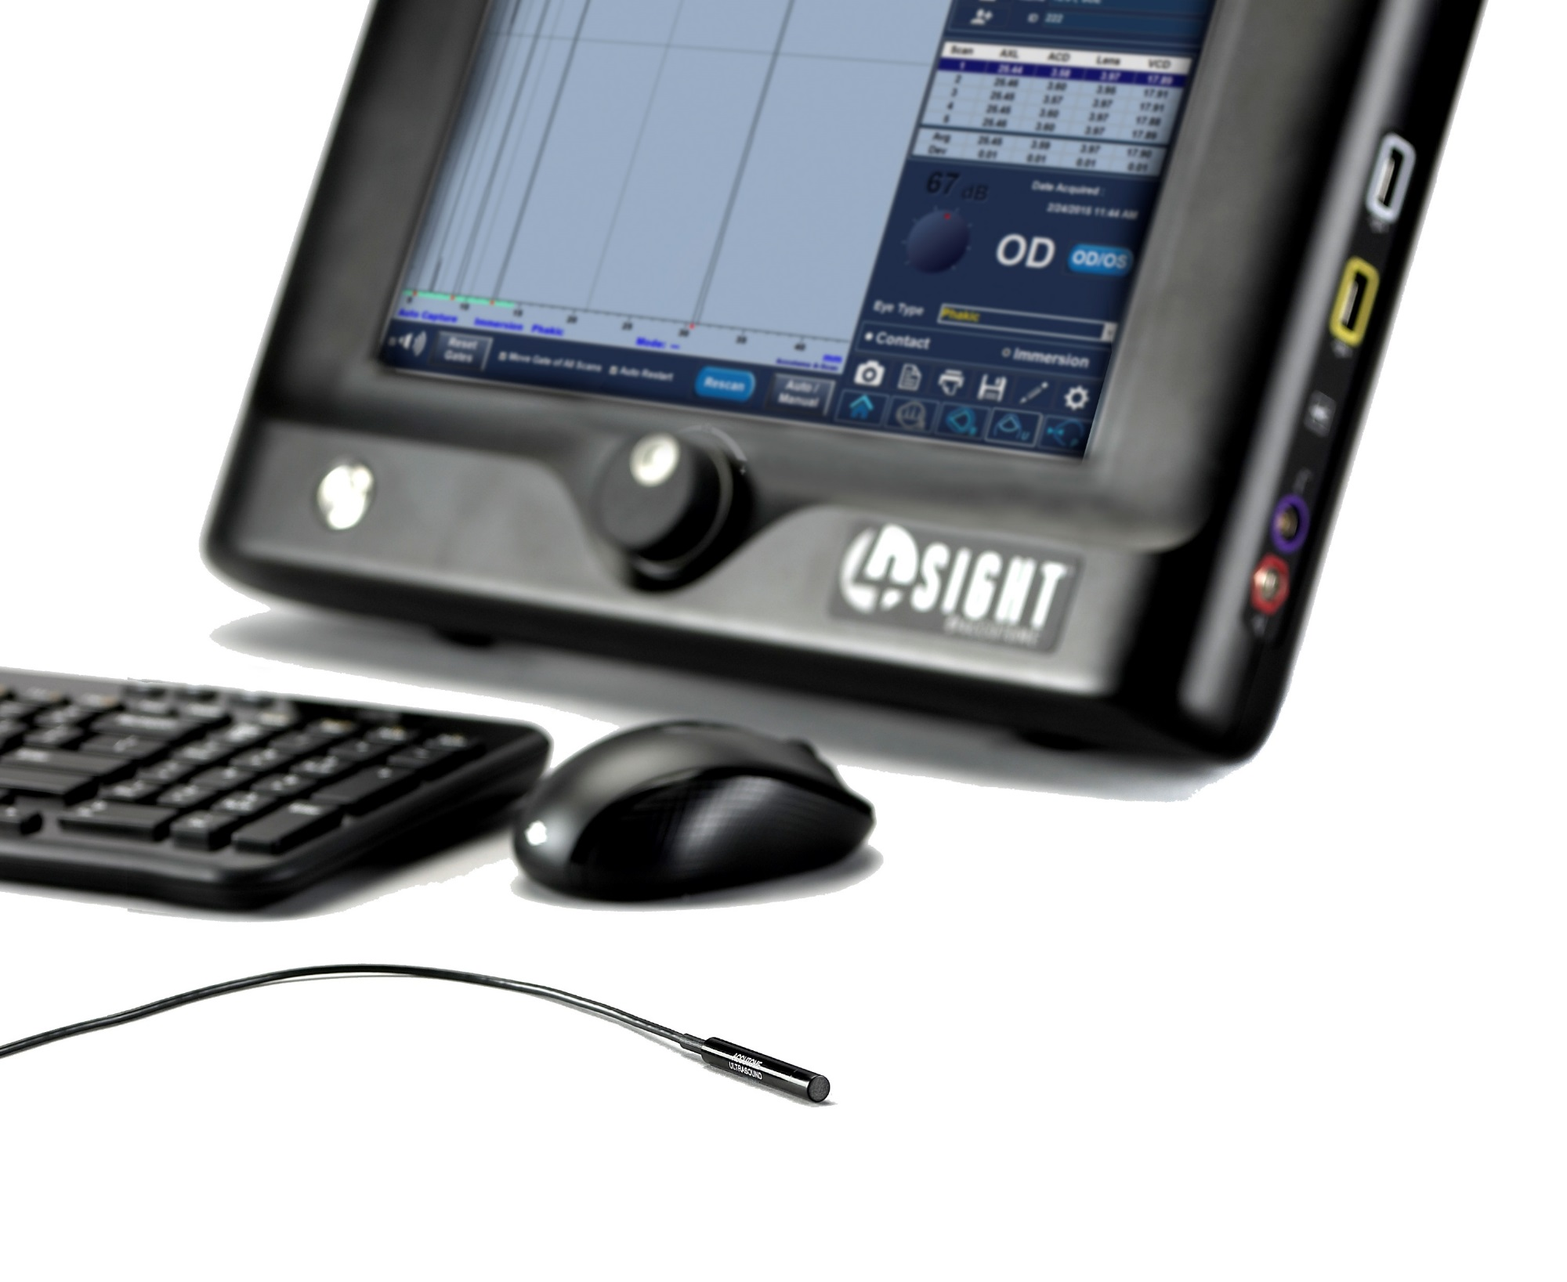
Accutome 4Sight: A-Scan

Slide 4
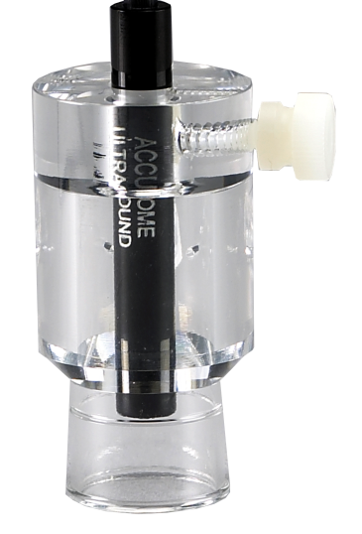
Probe Position
Insert probe through the hole on the top of the immersion shell. Do not push the probe past the scored line.
Gently twist the screw on the side of the shell, locking the probe into position. Do not over tighten.
Note: It is important that the probe does not pass the etched line in the immersion shell. If the probe is placed too far into the shell, you risk missing part of the cornea spike.
2.
1.

Slide 5
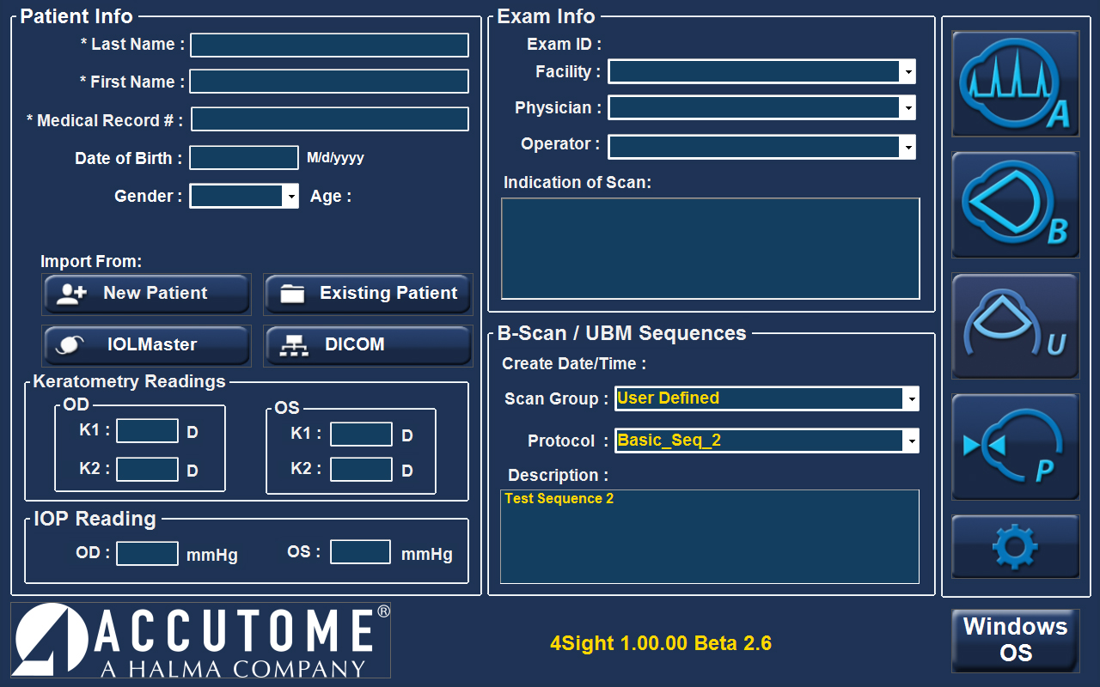
A-Scan New Exam
To begin a new exam, click the New Patient button and fill in the appropriate fields for patient information. Once the appropriate fields have been filled, select the A-Scan icon.
A-Scan Icon
Patient Info
New Patient Button

Slide 6
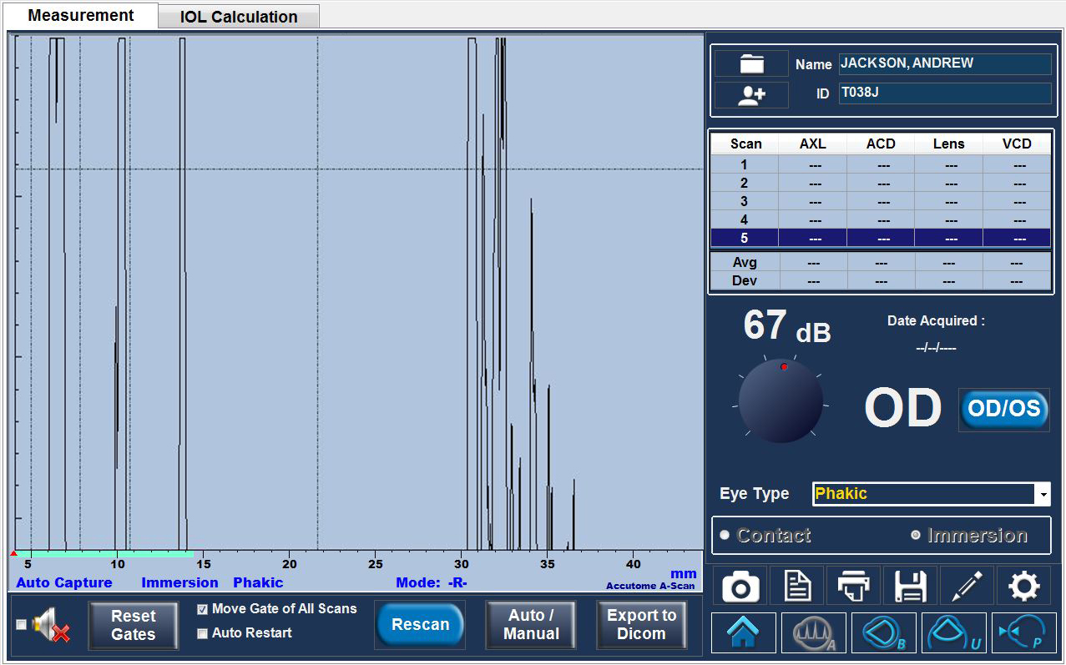
Measurement Screen
After entering the measurement screen, make sure all desired settings are selected, such as capture mode, immersion/contact, eye type, OD/OS, and Gain.
There are two control tabs used to navigate between Measurement and IOL Calculation Modes.
Measurement Screen and IOL Calculation Modes
Gain
Capture Mode
Eye Type
Contact/
Immersion

Slide 7
Scan Alignment
Proper scan alignment: All spikes must be present and reach top of screen.
Cornea
Back Of Lens
Sclera
Front of Lens
Retina

Slide 8
Scan Alignment
The most common errors are a weakened posterior lens or retina spike. If these spikes are weakened or do not reach the top of the screen, a slight adjustment to the immersion shell or patient fixation is needed.
Posterior Lens
Retina

Slide 9
Scan Alignment
A missing sclera spike indicates the probe is aimed into the optic nerve.
If getting an optic nerve shot, the shell should be adjusted inferior and temporally. An optic nerve scan where the sclera spike is not present will produce an erroneously long measurement.
Sclera

Slide 10
Gain
Increasing the gain amplifies the echoes on the display screen. More gain is required for denser cataracts.
When gain is too high, the scan becomes oversaturated resulting in a shorter than actual axial length.
To increase the gain, simply turn the knob on the screen with the mouse. Default gain should be around 67 dB.
Psuedophakic eyes will need the gain to be turned down to reduce noise produced from the intraocular lens.
Gain Knob

Slide 11
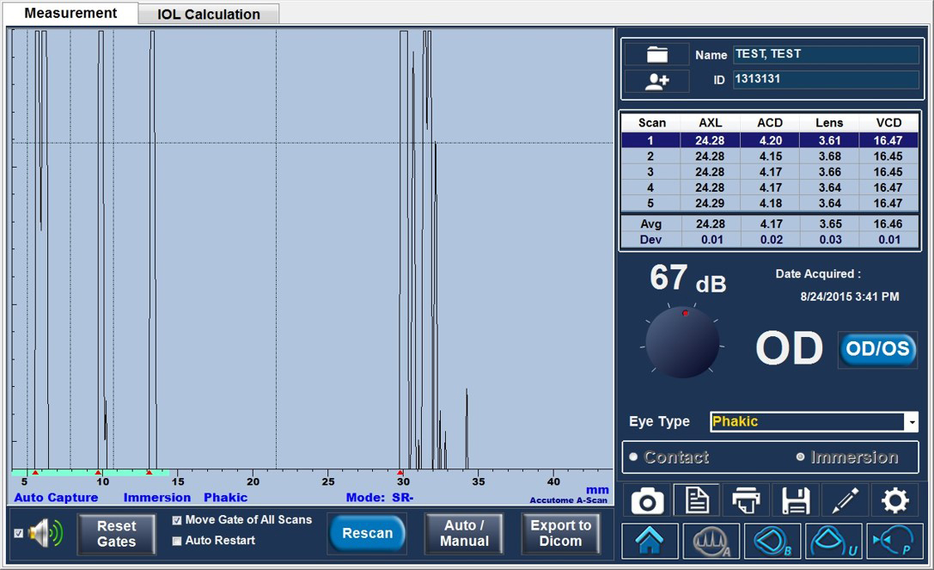
Gates
Gates are used by the software to detect and identify the different spikes in the waveform used to make the measurement. The gates are the dotted lines on the screen, and the markers (red triangles on the base line) mark the identified spike and point of measurement. In order to adjust the gates, simply “click and drag” the gate to the appropriate position– the red marker will move accordingly.

Slide 12
Reports
Print
Settings
Snapshot
Report
Save
Edit
Selecting Report under the measurement tab, will generate a 2 page A-Scan report. One page for OD, one for OS. This report will show all 5 scan waveforms for each eye.

Slide 13
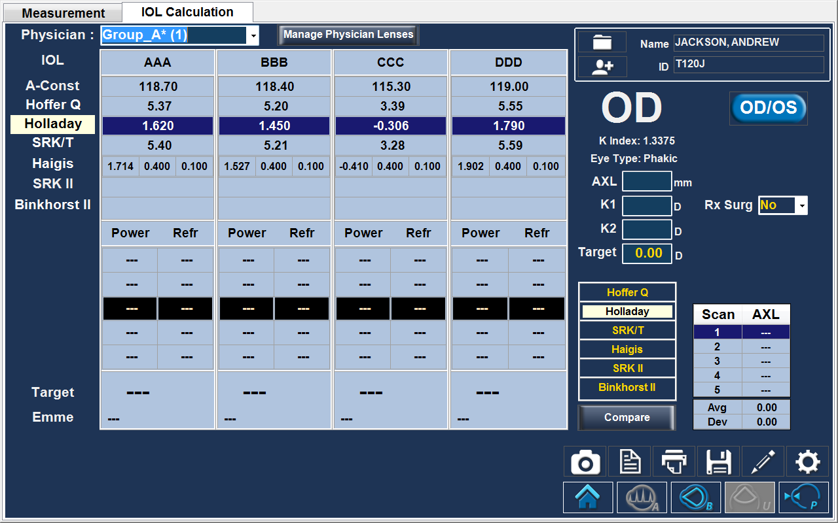
IOL Calculation
Select the IOL Calculation tab to enter the calculation screen
Switch between different lens groups
Add, Edit, or Delete Lenses/Lens Groups
AXL – Axial Length, K1, K2, and Post-Op target
Select desired formula for calculation
Select report to generate a 1 page calculations printout

Slide 14
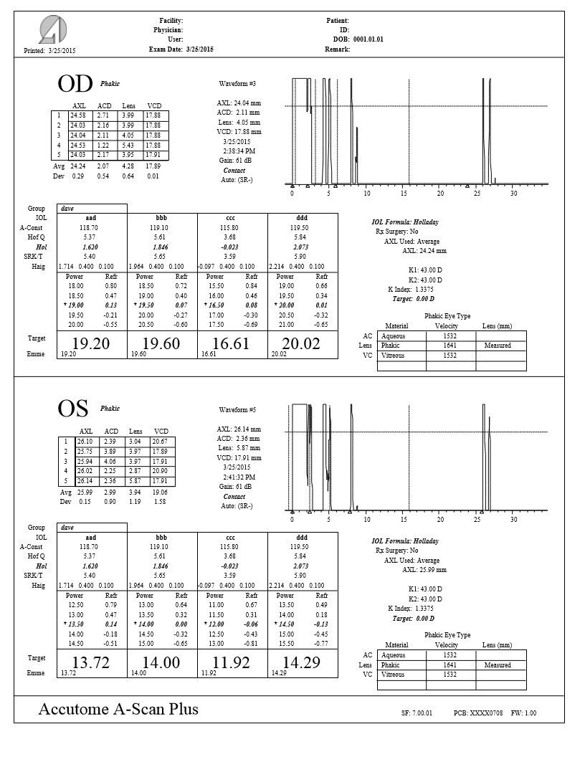
Sample of IOL Calculations Report

Slide 15
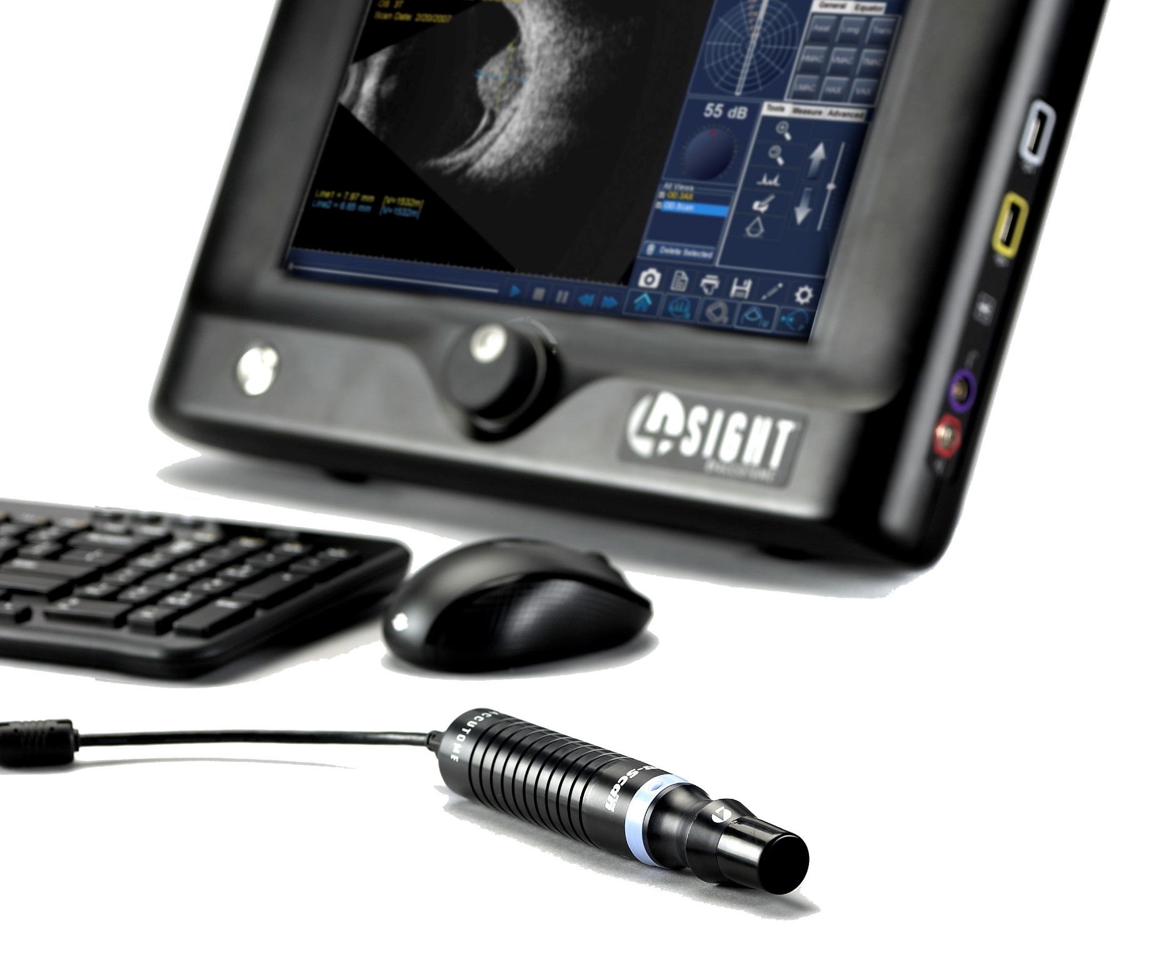
Accutome 4Sight: B-Scan

Slide 16
B-Scan New Exam
To begin a new exam, click the New Patient button and fill in the appropriate fields for patient information. When starting a B-Scan exam, make sure appropriate sequence is selected. Once the appropriate fields have been filled, select the B-Scan icon.
Patient Information
B-Scan Icon
New Patient Button
B-Scan/UBM Sequences

Slide 17
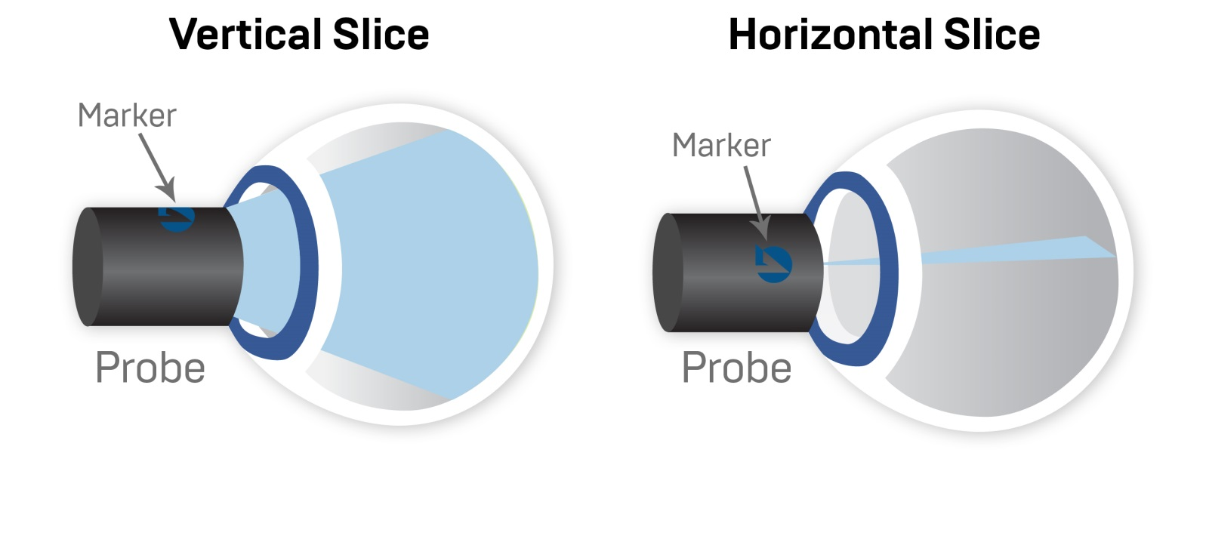
Probe Alignment
Accutome logo indicates direction of probe oscillation and the top of the screen
Start/Stop Button

Slide 18
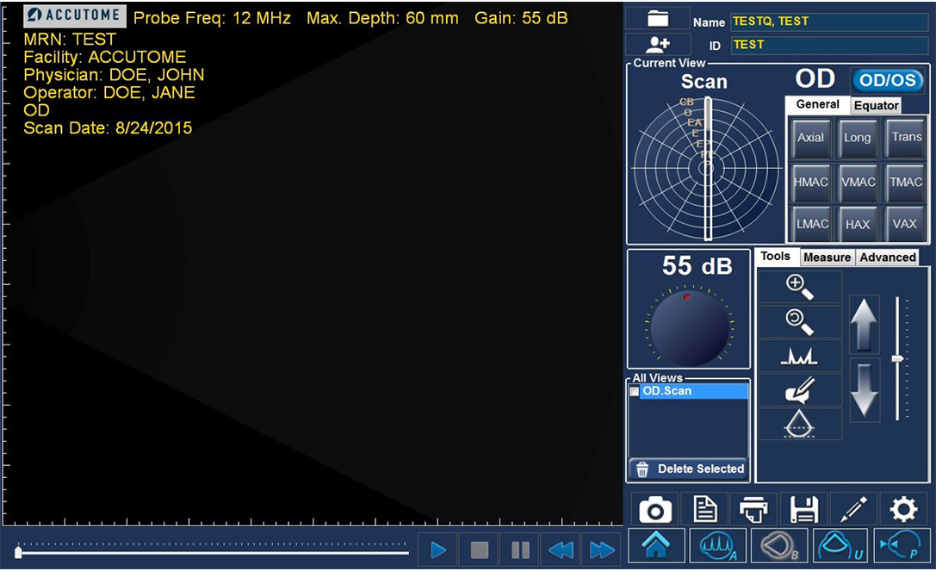
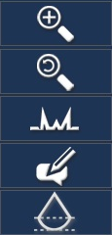
Scan Screen
Select eye OD/OS
Orientation dial used to label probe position (optional).
Zoom
Adjust gain while scanning
Zoom Reset
A-Vector
Take multiple video loops of different positions
Comment
Cine Buffer shows a progress bar when probe is running

Slide 19
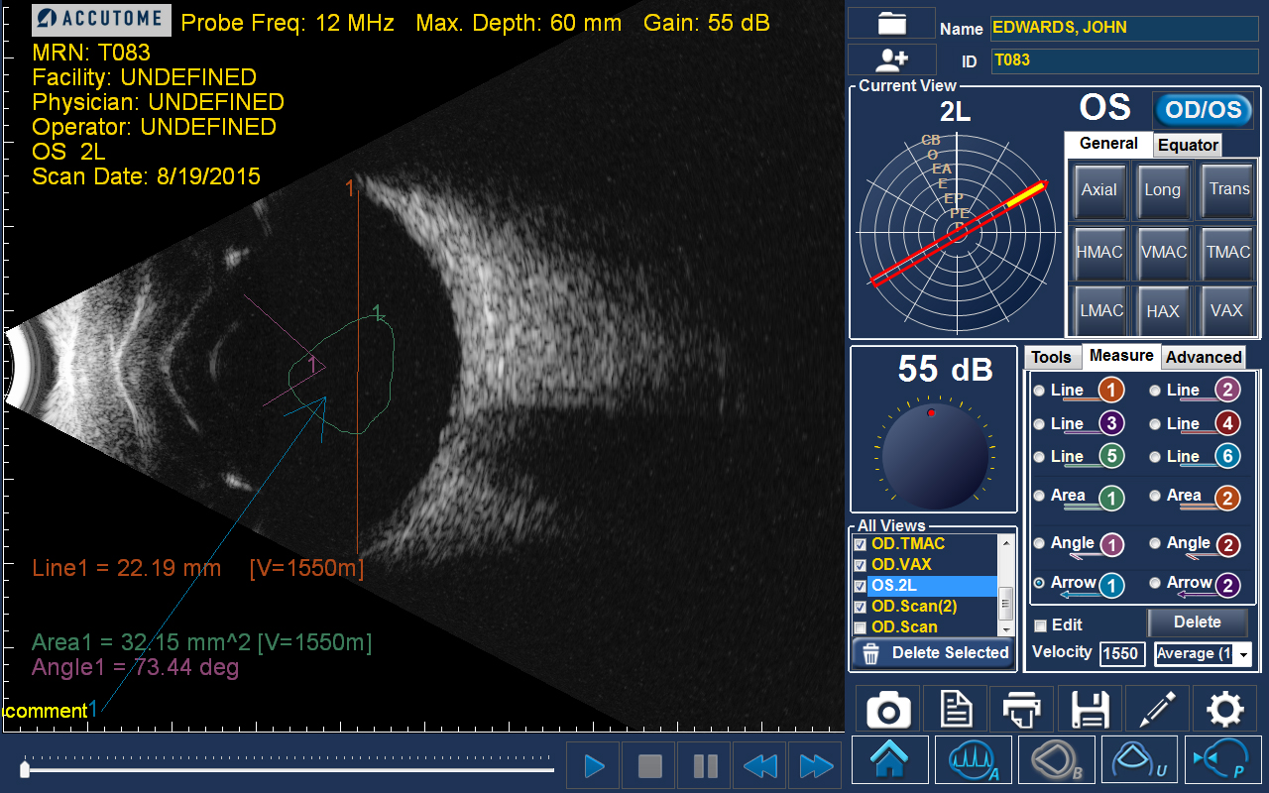
Scan Screen
Measure Tab:
6 lines, 2 area, and 2 angle calipers with 2 arrows
Play, Pause, and review the selected view frame by frame.
Snapshot
Report
Print
Save
Edit
Settings

Slide 20
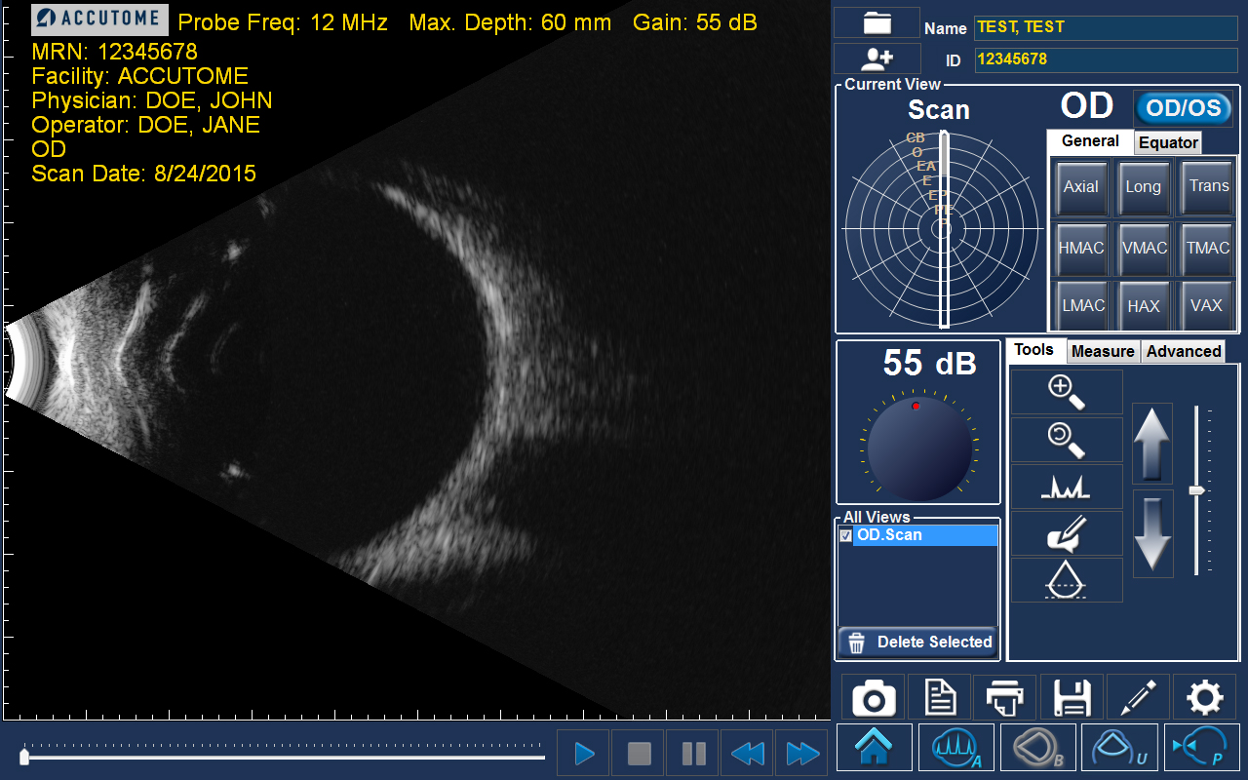
Reporting
Once all snapshots are taken, select the Report icon.
Report Icon

Slide 21
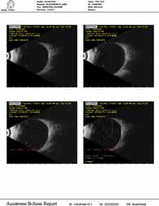
Reporting
Report Options:
Preview - brings up the report page as it will look with selected snapshots.
Save - saves the report in the folder designated in Setup: General.
Review - brings up a list of all of the reports saved for the selected patient.
Print – prints the selected scan.
Export to DICOM - the selected report exports to the DICOM location designated in Setup: General/ DICOM Servers
Report Options
Your snapshots will appear at the top of the screen.
Hold down the “Ctrl or Shift key” on your keyboard and click on the snapshots you wish to include in your report. Once selected, click “Preview”.

Slide 22
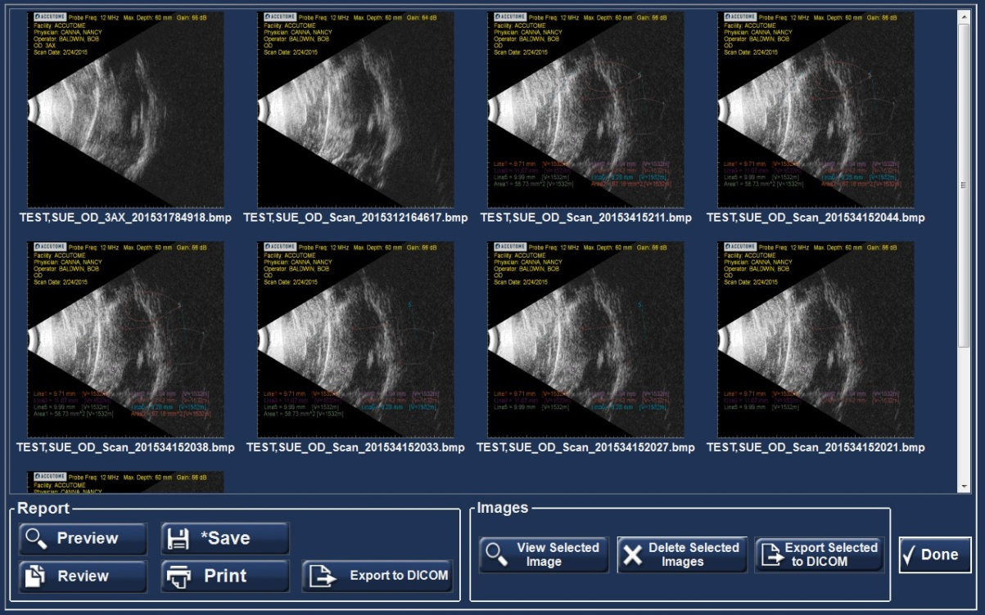
Image Options
View Selected Icon - brings up a larger version of the selected snapshot.
Delete Selected Images – deletes selected snapshots.
Export Selected to DICOM – send the selected image to the DICOM location designated in Setup: General / DICOM Servers.
Done - will bring you back to the scan window.
Done Icon
Image Options

Slide 23
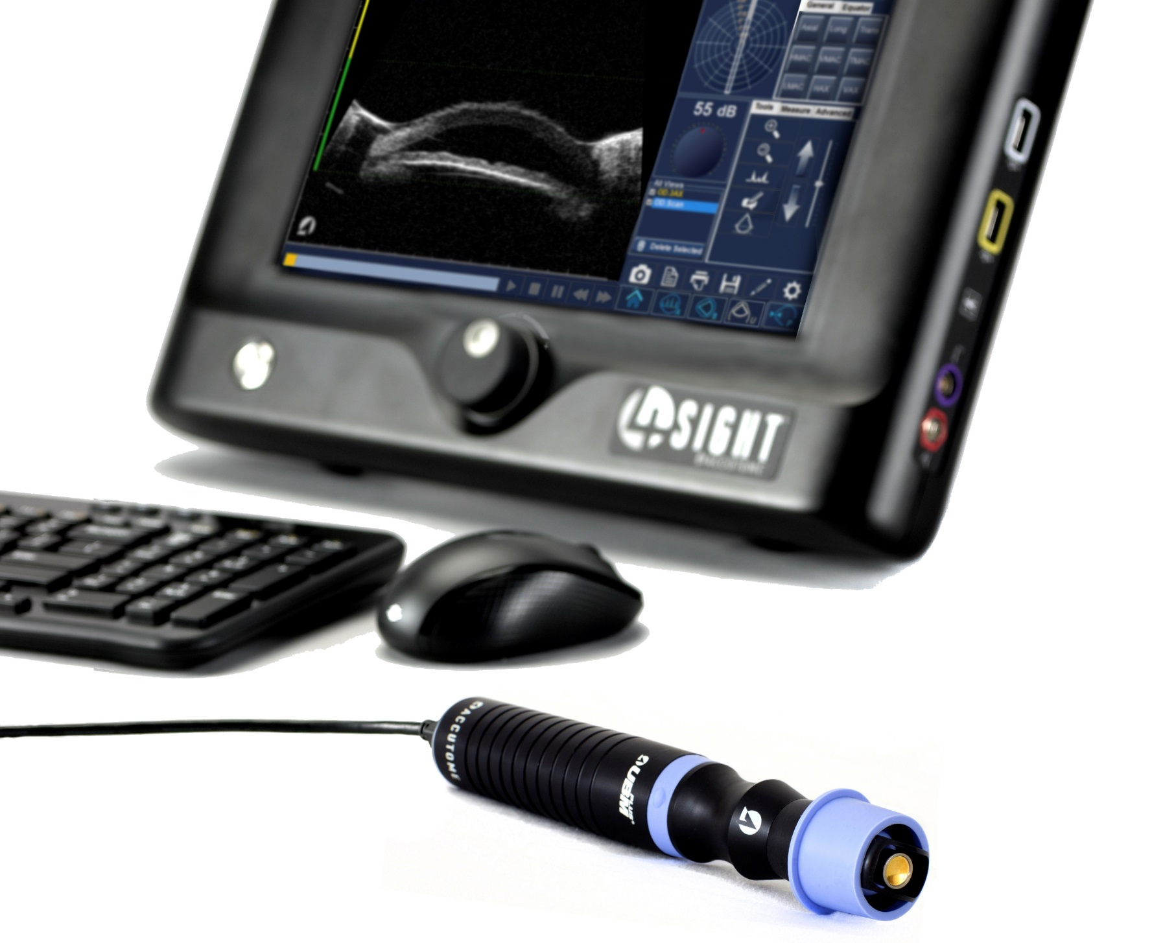
Accutome 4Sight: UBM

Slide 24
Probe Alignment
Accutome logo indicates direction of probe oscillation
Start/Stop Button

Slide 25
UBM New Exam
To begin a new exam click the New Patient button and fill in the appropriate fields for patient information. When starting a UBM exam, make sure appropriate Sequence is selected. Once the appropriate fields have been filled, select the UBM icon to begin the UBM mode.
Patient Information
New Patient Button
UBM Icon
B-Scan/UBM Sequences

Slide 26
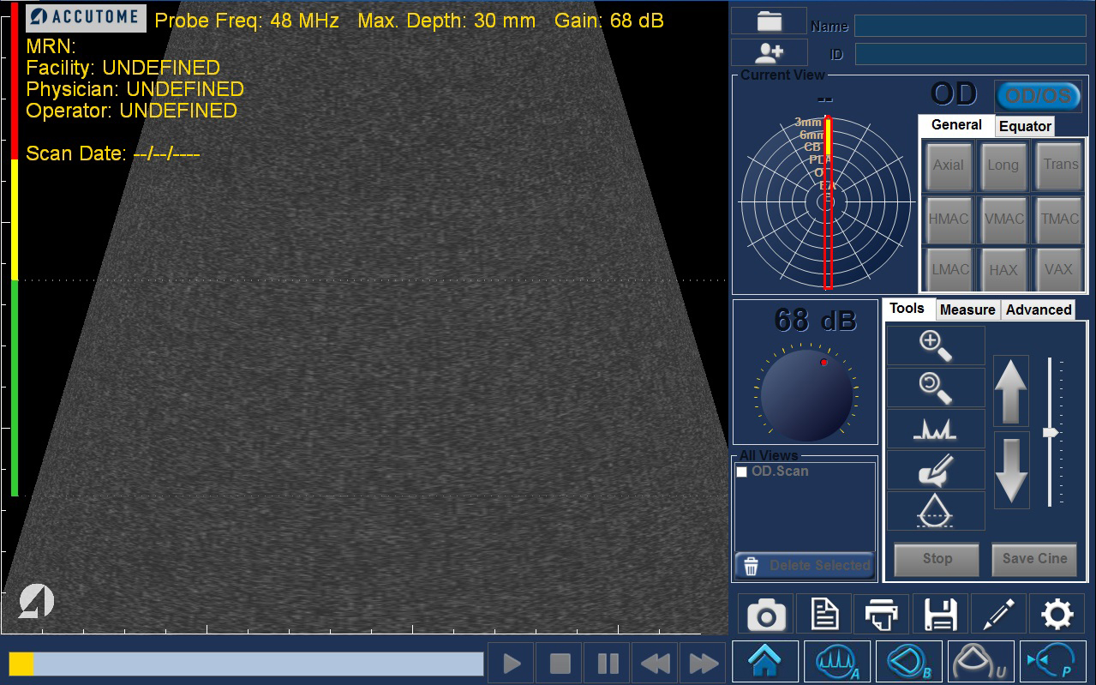
Scan Screen
Select eye OD/OS
Orientation dial used to label probe position (optional).
Zoom
Adjust gain while scanning
Zoom Reset
A-Vector
Take multiple video loops of different positions
Comment
UBM Focal Guide
Cine Buffer shows a progress bar when probe is running

Slide 27
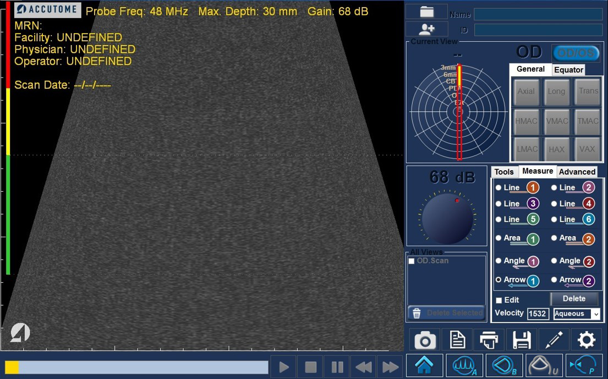
Scan Screen
Measure Tab:
6 lines, 2 area, and 2 angle calipers with 2 arrows
Play, Pause, and review the selected view frame by frame.
Snapshot
Report
Print
Save
Edit
Settings

Slide 28
Reporting
Once all snapshots are taken, select the Report icon. Selecting this button brings up a screen showing small versions of all of the snapshots which are stored for the patient selected.
Report Icon

Slide 29
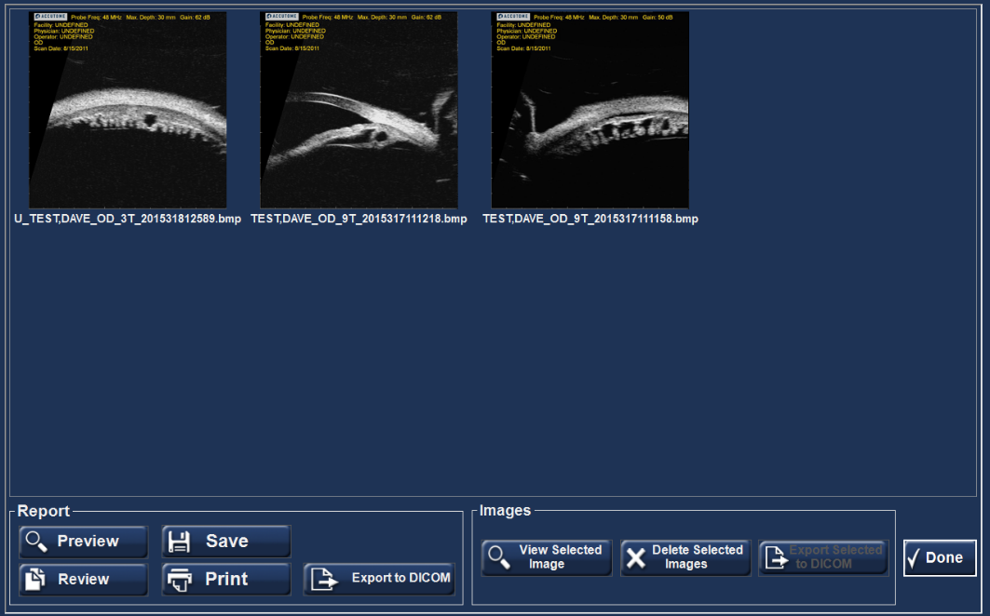
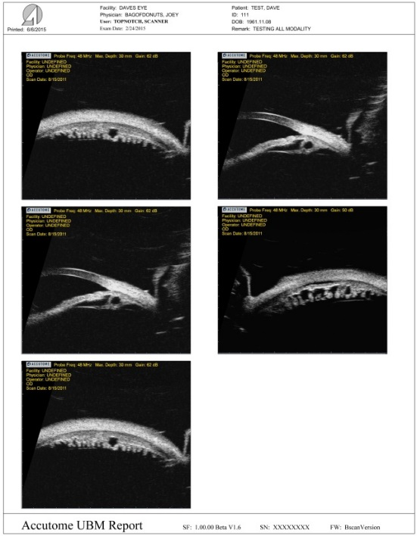
Reporting
Report Options:
Preview - brings up the report page as it will look with selected snapshots.
Save - saves the report in the folder designated in Setup: General.
Review - brings up a list of all of the reports saved for the selected patient.
Print – prints the selected scan.
Export to DICOM - the selected report exports to the DICOM location designated in Setup: General/ DICOM Servers
Report Options
Your snapshots will appear at the top of the screen.
Hold down the “Ctrl or Shift key” on your keyboard and click on the snapshots you wish to include in your report. Once selected, click “Preview”.

Slide 30
Image Options
View Selected Icon - brings up a larger version of the selected snapshot.
Delete Selected Images – deletes selected snapshots.
Export Selected to DICOM – send the selected image to the DICOM location designated in Setup: General / DICOM Servers.
Done - will bring you back to the scan window.
Done Icon
Image Options

Slide 31
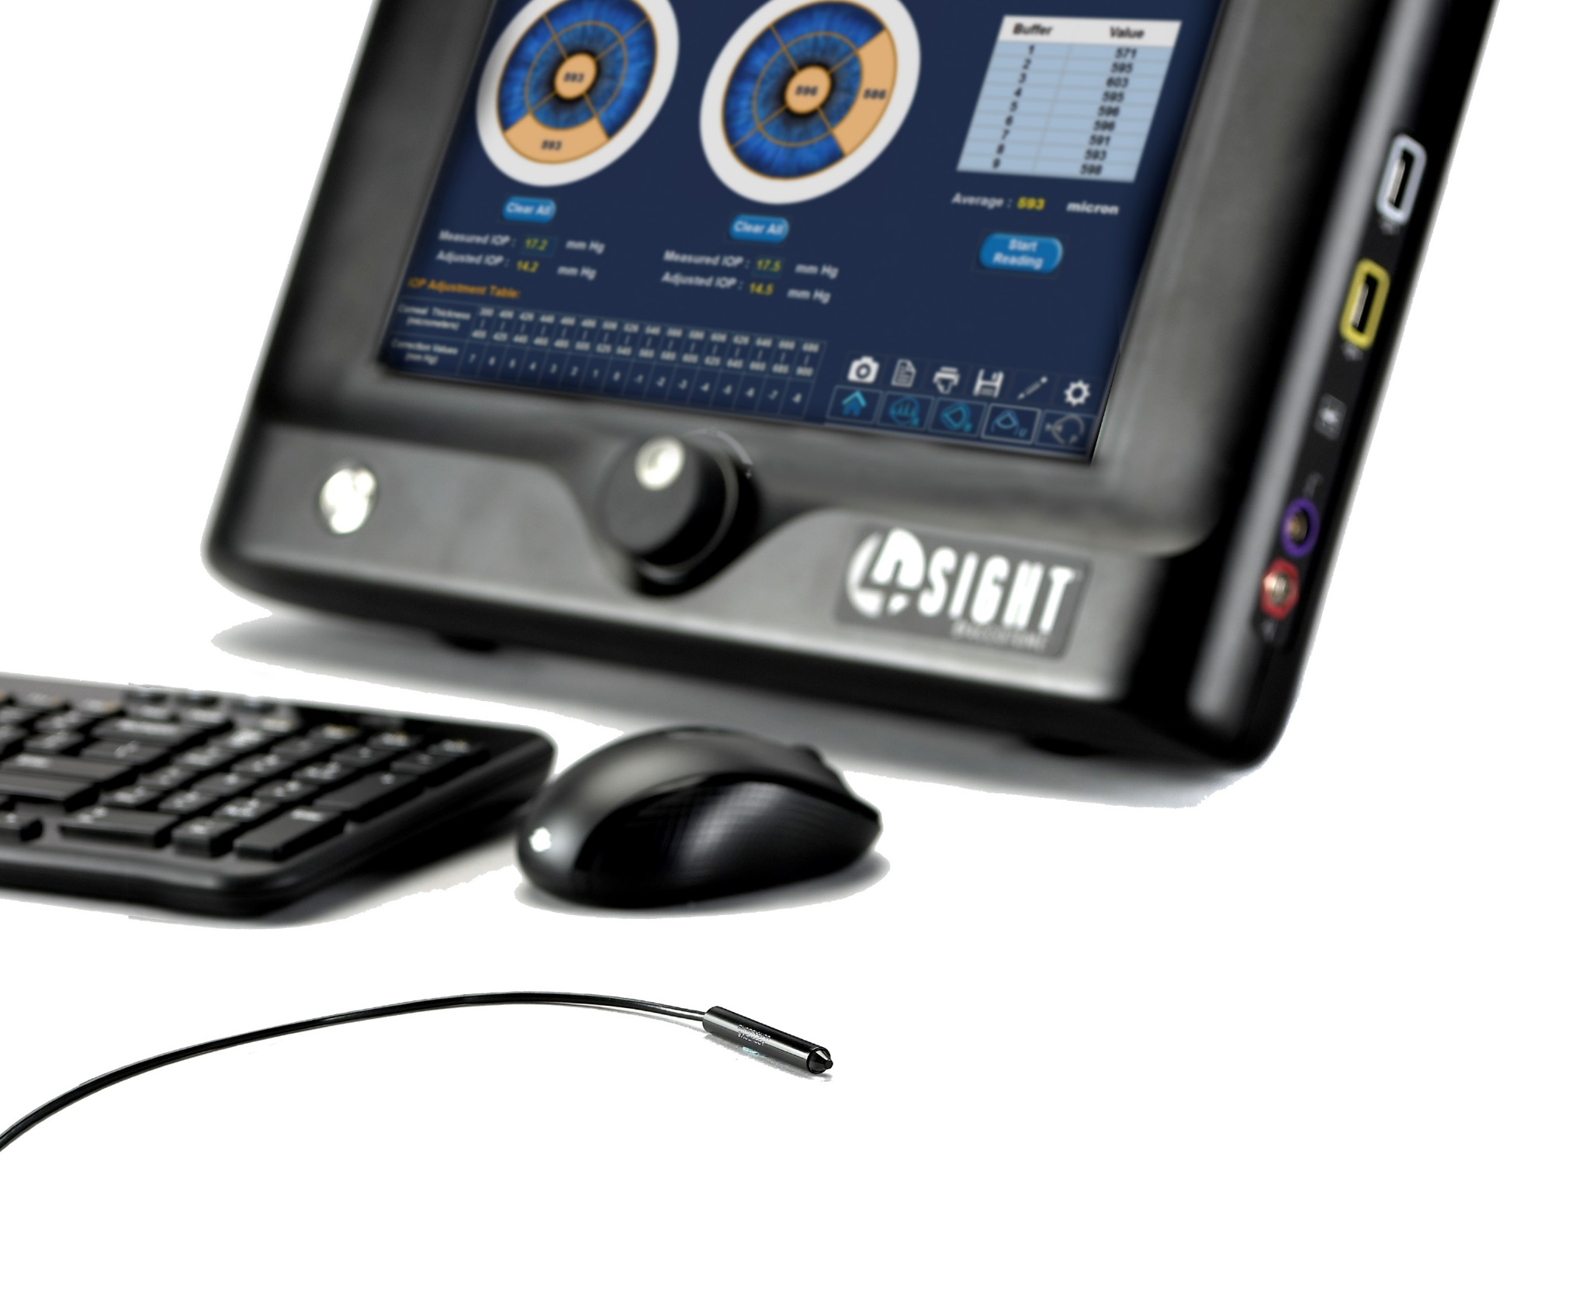
Accutome 4Sight: Pachymeter

Slide 32
Pachymetry New Exam
To begin a new exam, click the New Patient button and fill in the appropriate fields for patient information. Once the appropriate fields have been filled, select the Pachymetry icon.
Patient Information
New Patient Button
Pachymeter
Icon

Slide 33
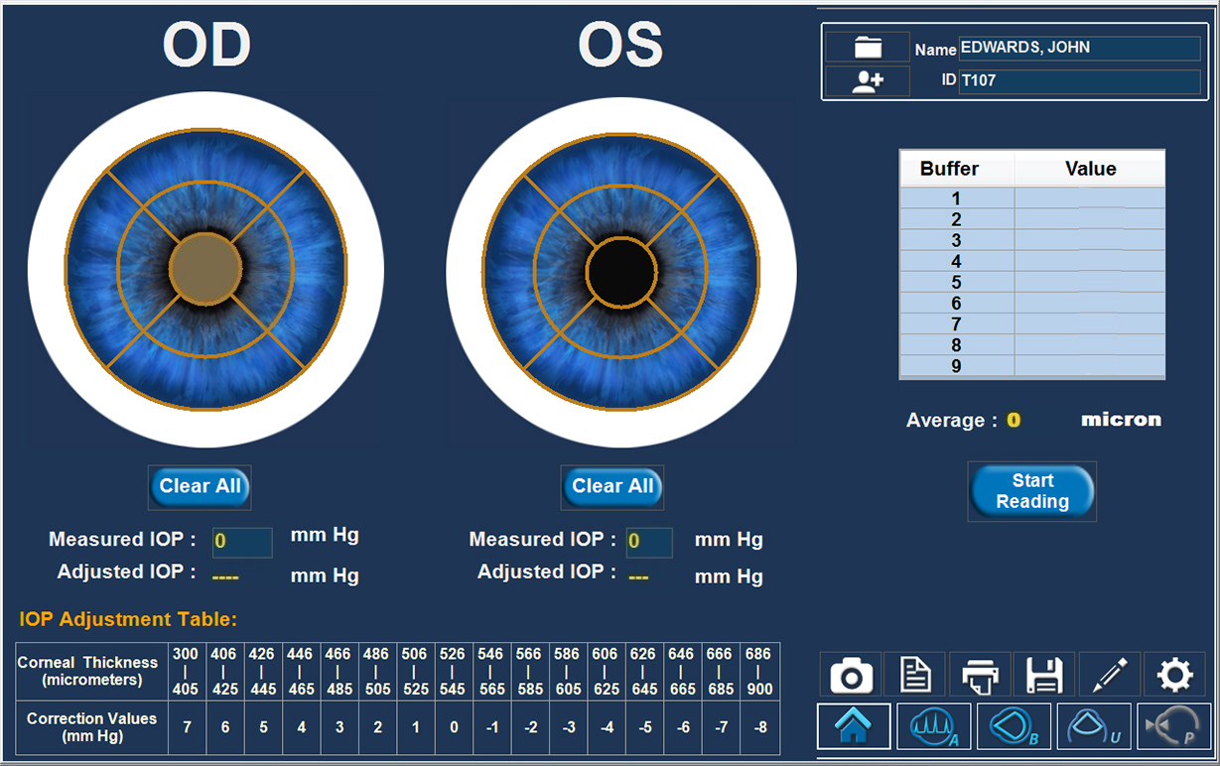
Measurement Screen
Place probe on the eye in the location selected on the screen. The flat portion of the probe tip should be perpendicular and completely in contact with the patient’s cornea (not at an angle). Measurements will not be obtained unless the probe is in complete contact with the cornea.
Select the eye OD/OS and the scan location on the cornea
Start Reading will begin the scan

Slide 34
Measurement Screen
Once you have captured 9 measurements, you may review those measurements in the chart on the right of the screen.
Repeat process on different locations of the cornea or on fellow eye
Select Save to save all scans
After Save, Select Report icon. Selecting this will generate a Pachymetry Report.
Report
Save

Slide 35
Sample Pachymetry Report
All Regions scanned will display on the report giving all nine measurements and the average for that location.
Entering a Measured IOP will then calculate an adjusted IOP based on the pachymetry measurements.

Slide 36
Notes
_______________________________________________________________________________________________________________________________________________________________________________________________________________________________________________________________________________________________________________________________________________________________________________________________________________________________________________________________________________________________________________________________________________________________________________________________________________________________________________________________________________________________________________________________________________________________________________________________________________________________________________________________________________________________________________________________________________________________________

