Slide 1
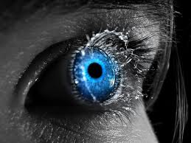
Accutome A-scan Plus Connect ® Visual Aid

Slide 2
Probe Position
1.Insert probe through the hole on the top of the immersion shell. Do not extend the probe past the scored line.
2. Twist the screw on the side of the shell, locking the probe into position. Do not over tighten.

Slide 3
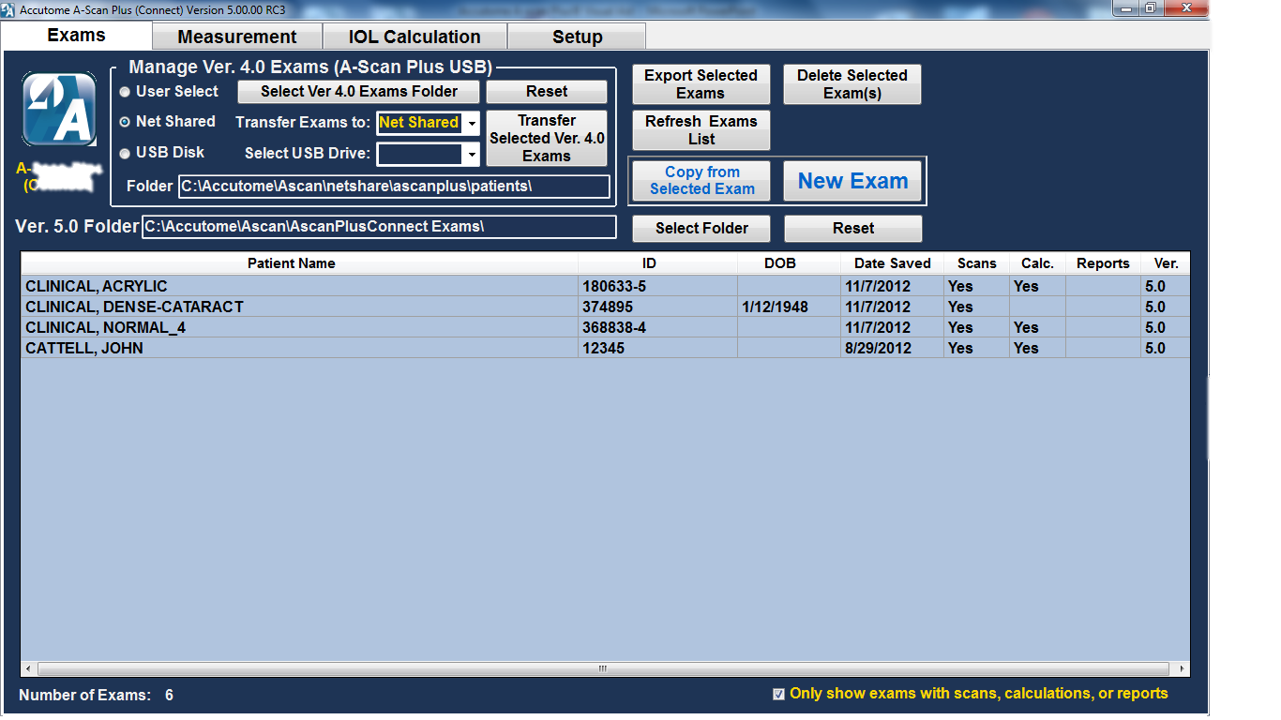
Control Tabs
Used to navigate to different screens within the software. Each tab takes your to the corresponding screen for things like transferring or recalling exams, viewing a measurement for a patient, performing an IOL implant calculation or customizing the software setup to meet your particular needs.

Slide 4
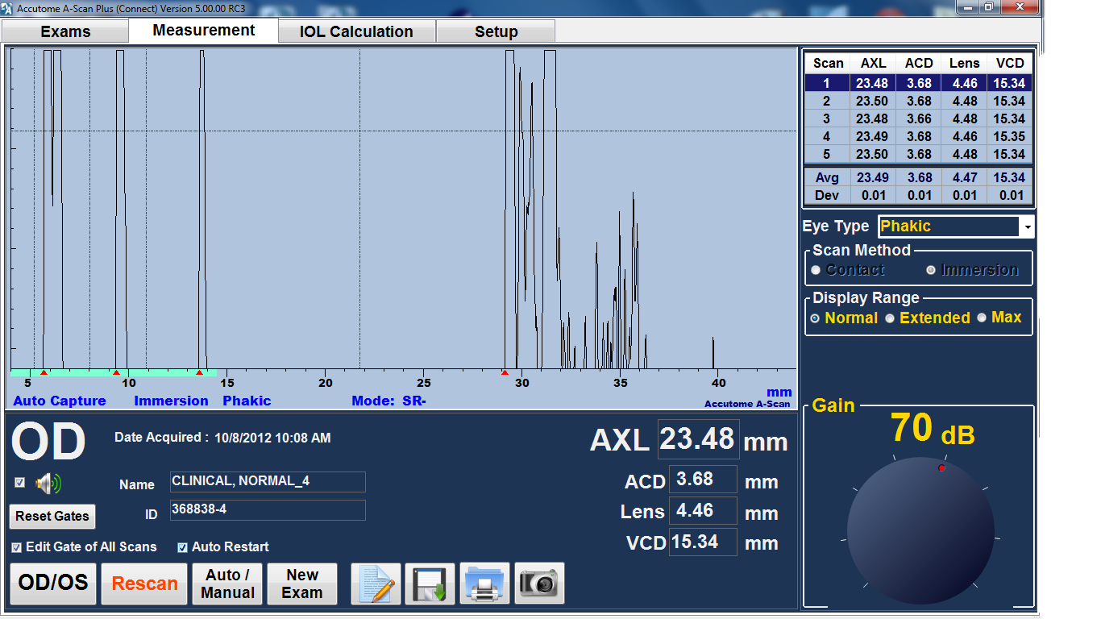
Scan Alignment
Proper scan alignment
Front of lens
Cornea
Back of lens
Retina
Sclera

Slide 5
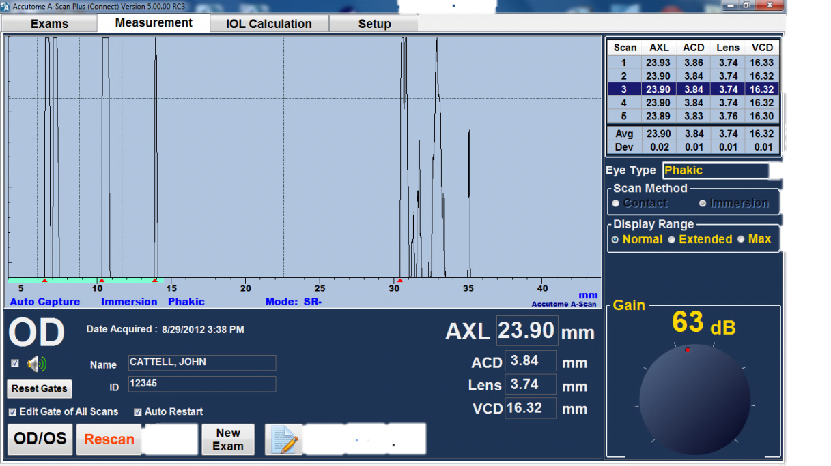
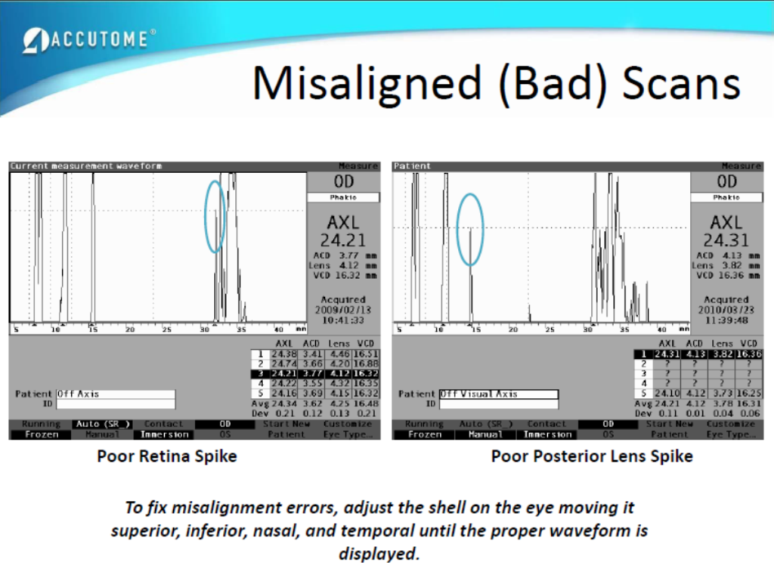
Scan Alignment
Misaligned scans will not show all 5 spikes. The most common errors are a diminished posterior lens spike or a diminished retina spike. If these spikes are diminished or missing a slight adjustment of the immersion shell is needed
Posterior lens
Retina

Slide 6
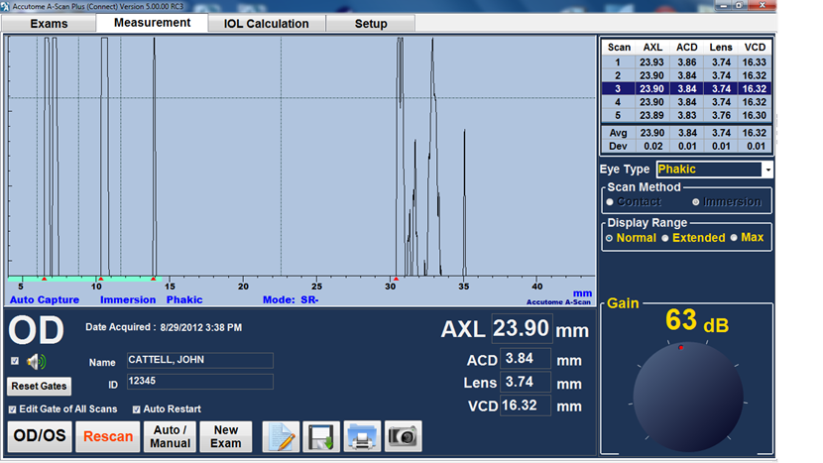
Scan Alignment
A missing sclera spike indicates an optic nerve shot, you must adjust the shell in order to aim the sound beam away from the optic nerve and towards the macula.
Sclera
If getting an optic nerve shot one normally needs to aim inferior and temporal. The shell must be adjusted, this scan will give a falsely long axial length.

Slide 7
Probe Placement
It is imperative that the probe not go past the etched line in the immersion shell, if the probe is placed to far into the shell the cornea will be removed giving a measurement error.

Slide 8
Gain
To increase the gain simply turn the knob on the screen with the mouse. Default gain should be around 61 dB

Slide 9
Gates
Gates are used by the software to mark the appropriate peaks in order to measure axial length. The gates are the dotted lines on the measurement screen, and the markers “mark the peak”. In order to adjust the gates simply “click and drag” the gate to the location you prefer.

Slide 10
Notes
___________________________________________________________________________________________________________________________________________________________________________________________________________________________________________________________________________________________________________________________________________________________________________________________________________________________________________________________________________________________________________________________________________________________________________________________________________________________________________________________________________________________________________________________________________________________________________________________________________________________

